Slide 1
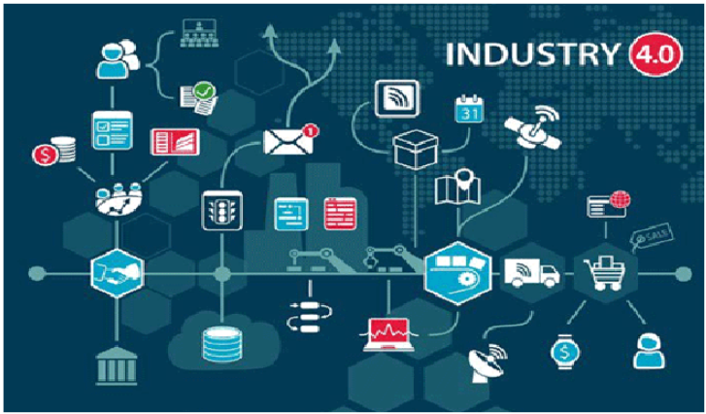
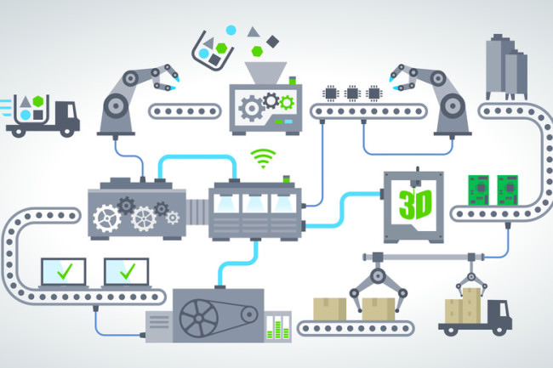

개발 위한 학습 자원

Slide 2
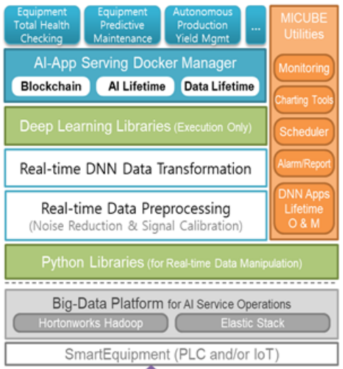
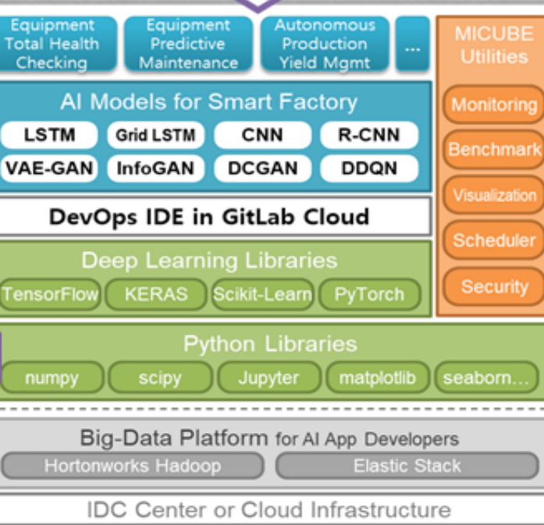
산업전문인력AI역량강화
중간관리자 과정
강사
드림랩, 이사
키센스, 기술이사
스마트시스템연구단 책임연구원
인텔 코리아 부장
LG전자 책임연구원
AI 컨설턴트, MBA, PMP, 애자일코치
kimhe1@drimlab.com
https://www.linkedin.com/in/heewon-kim-95531724/
김희원

Slide 3
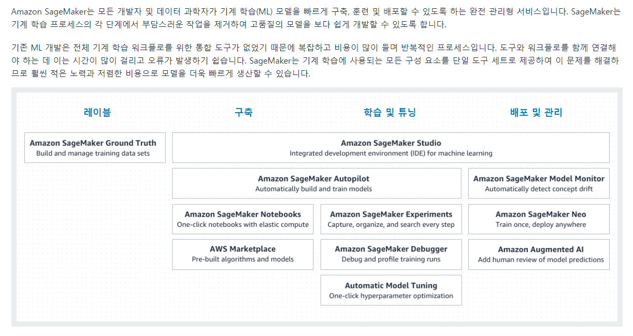
Cloud 기반 AI 서비스
https://aws.amazon.com/ko/sagemaker/

Slide 4
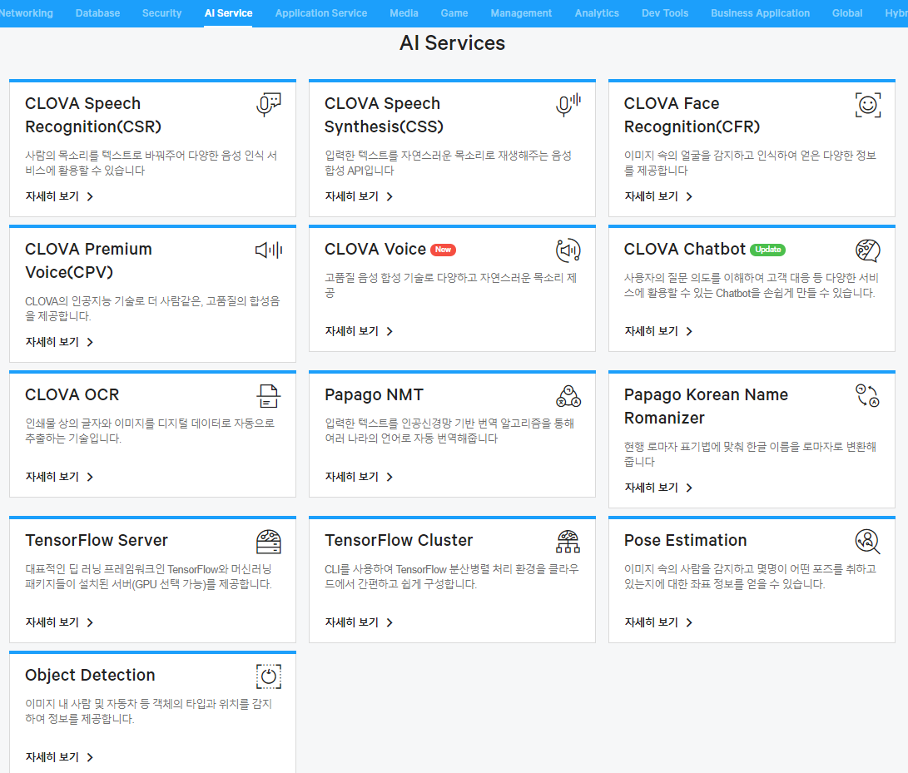
Cloud 기반 AI 서비스
https://www.ncloud.com/product/aiService

Slide 5
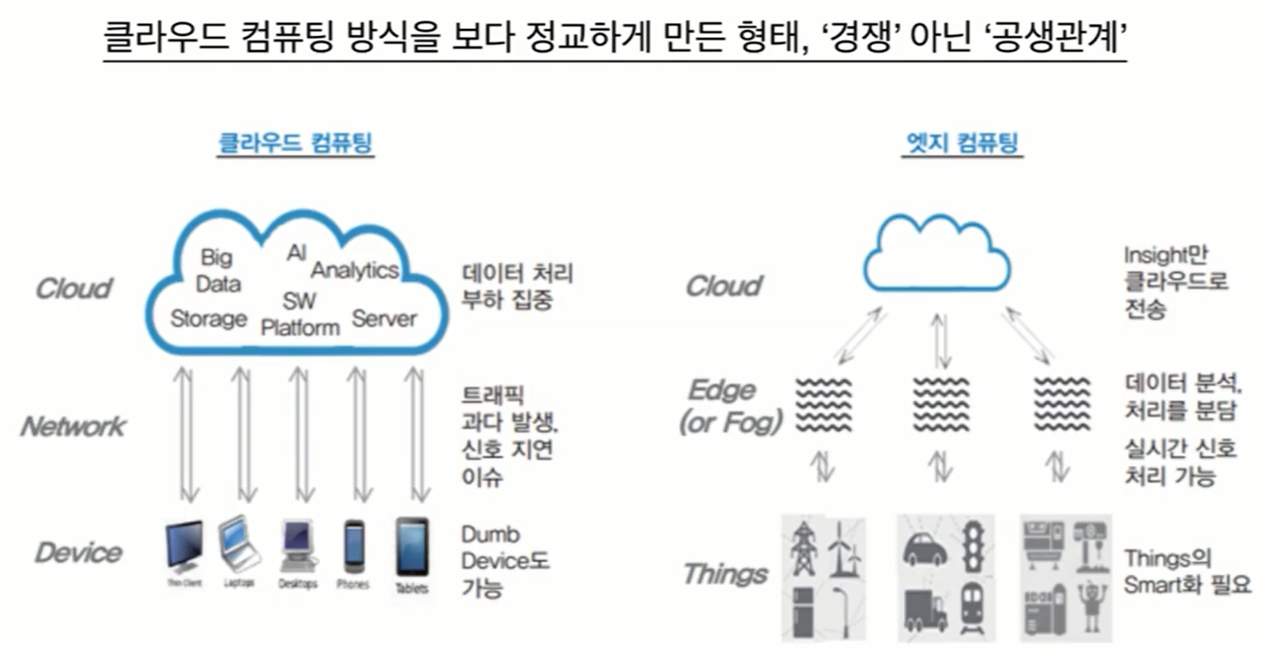
Cloud vs Edge
https://www.drimaes.com

Slide 6
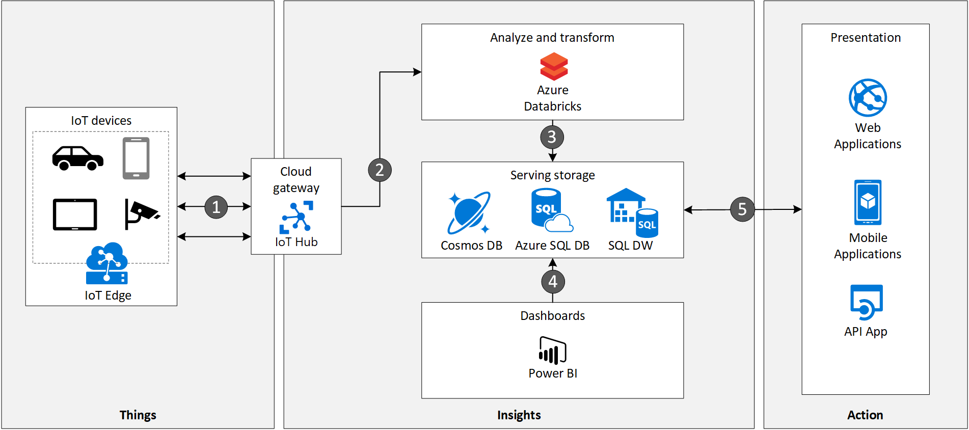
Hybrid Cloud
https://docs.microsoft.com/en-us/azure/architecture/

Slide 7
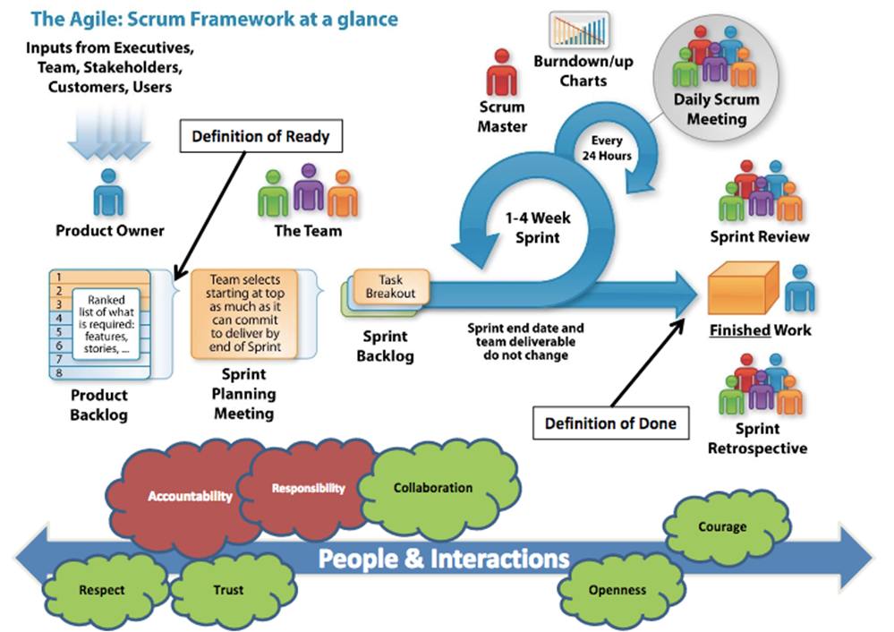

DRIMLAB AI Agile Development – Agile Process
www.drimaes.com

Slide 8
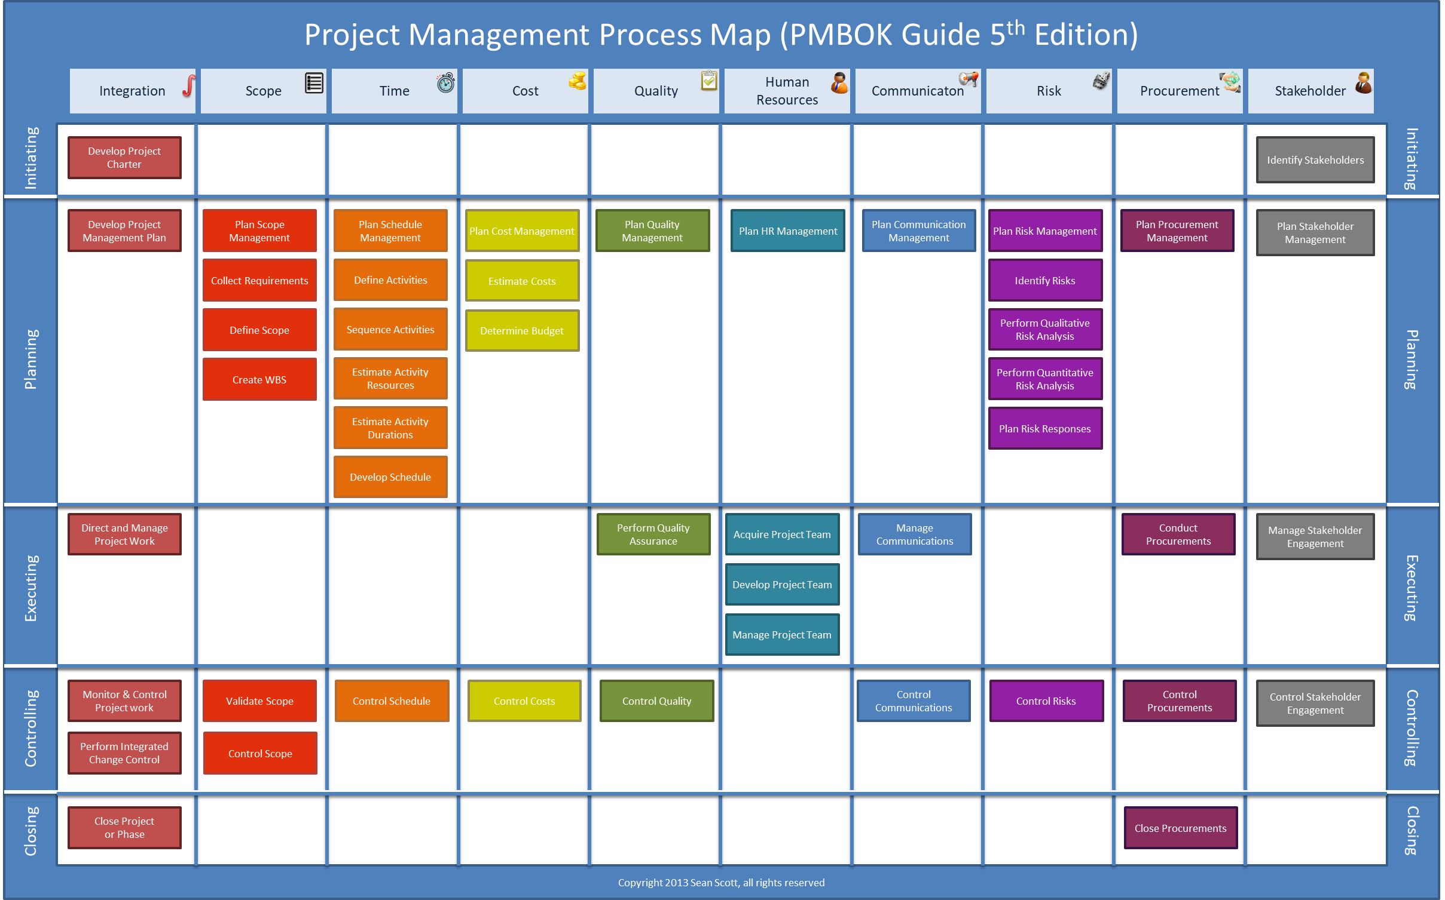
DRIMLAB AI Agile Development - PMBOK
www.drimaes.com

Slide 9
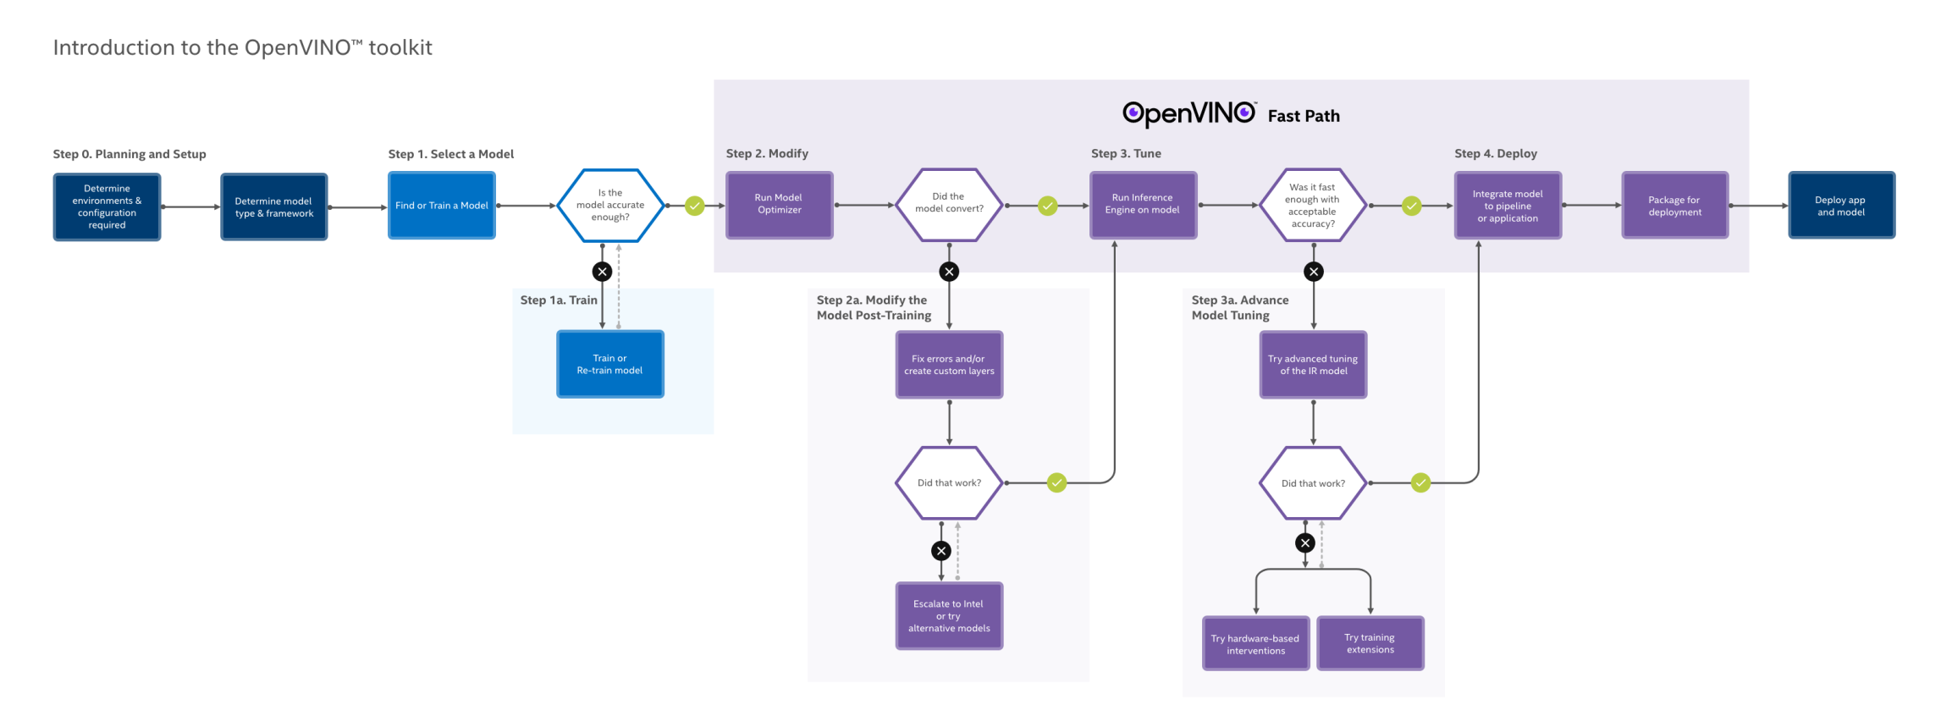
DRIMLAB AI Agile Development
https://software.intel.com/content/www/us/en/develop/articles/get-started-with-neural-compute-stick.html

Slide 10

DRIMLAB AI Agile Development
https://software.intel.com/content/www/us/en/develop/articles/get-started-with-neural-compute-stick.html

Slide 11
DRIMLAB AI Agile Development
https://software.intel.com/content/www/us/en/develop/articles/get-started-with-neural-compute-stick.html

Slide 12
DRIMLAB AI Agile Development
https://software.intel.com/content/www/us/en/develop/articles/get-started-with-neural-compute-stick.html

Slide 13
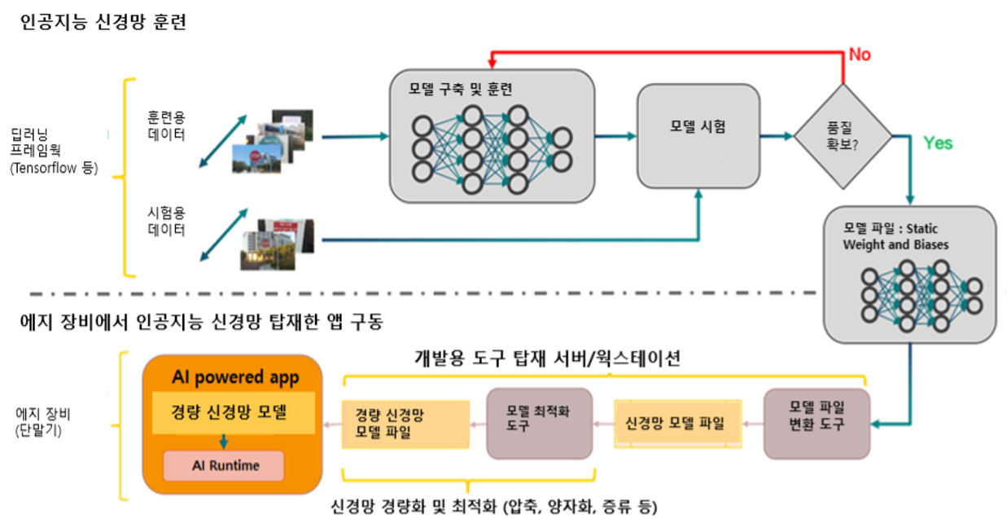
DRIMLAB AI Agile Development
www.drimaes.com

Slide 14
DRIMLAB AI Agile Development
AI technical tools
Machine learning frameworks: Research publications:
TensorFlow - Arxiv
PyTorch
Keras
MXNet
CNTK Open source repositories:
Caffe - GitHub
PaddlePaddle
Scikit-learn
R
Weka

Slide 15
DRIMLAB AI Agile Development
Tools for Agile process
MIRO for planning
Figma for design
ASANA agile tool
MS project for project management
https://arxiv.org/
Github
Bitbucket
Google Drive
Baidu Drive
Weiyun
Notion for making notes
Jandi
Slack

Slide 16
DRIMLAB AI Agile Development
Cloud service
Naver Cloud Platform
Kakao Cloud Platform
MS Azure
KT Cloud
AWS
Google Cloud Platform
On-premise
Windows
Ubuntu/CentOS
Framework
PyTorch
Tensorflow
Caffe
OpenVino
Language
Python, PyQt
C++, C#
Java, JS, node.js
Go, react, PHP

Slide 17
DRIMLAB AI Agile Development
Environment setup (local pc)
Anaconda https://www.anaconda.com/
Visual Studio Community https://visualstudio.microsoft.com/ko/thank-you-downloading-visual-studio/?sku=Community&rel=16
CUDA, CUDNN
https://developer.nvidia.com/cuda-10.0-download-archive?target_os=Windows&target_arch=x86_64&target_version=10&target_type=exelocal
Git https://git-scm.com/download/win
Docker https://hub.docker.com/editions/community/docker-ce-desktop-windows

Slide 18
DRIMLAB AI Agile Development
Environment setup (local pc)
pyTorch https://pytorch.org/get-started/locally/
Tensorflow https://www.tensorflow.org/install/gpu?hl=ko
OpenVino https://docs.openvinotoolkit.org/latest/openvino_docs_install_guides_installing_openvino_windows.html#Install-Core-Components
Pycharm https://pytorch.org/get-started/locally/
intelliJ https://www.tensorflow.org/install/gpu?hl=ko
Vscode https://code.visualstudio.com/

Slide 19
DRIMLAB AI Agile Development
Environment setup (Cloud service, 계정 생성)
COLAB https://colab.research.google.com/ (gmail 계정 로그인)
Google Cloud https://cloud.google.com/ (gmail 계정 로그인)
AWS https://aws.amazon.com/ko/
Microsoft Azure https://azure.microsoft.com/ko-kr/ (MS, Windows 계정 로그인)
Naver Cloud https://www.ncloud.com/

Slide 20
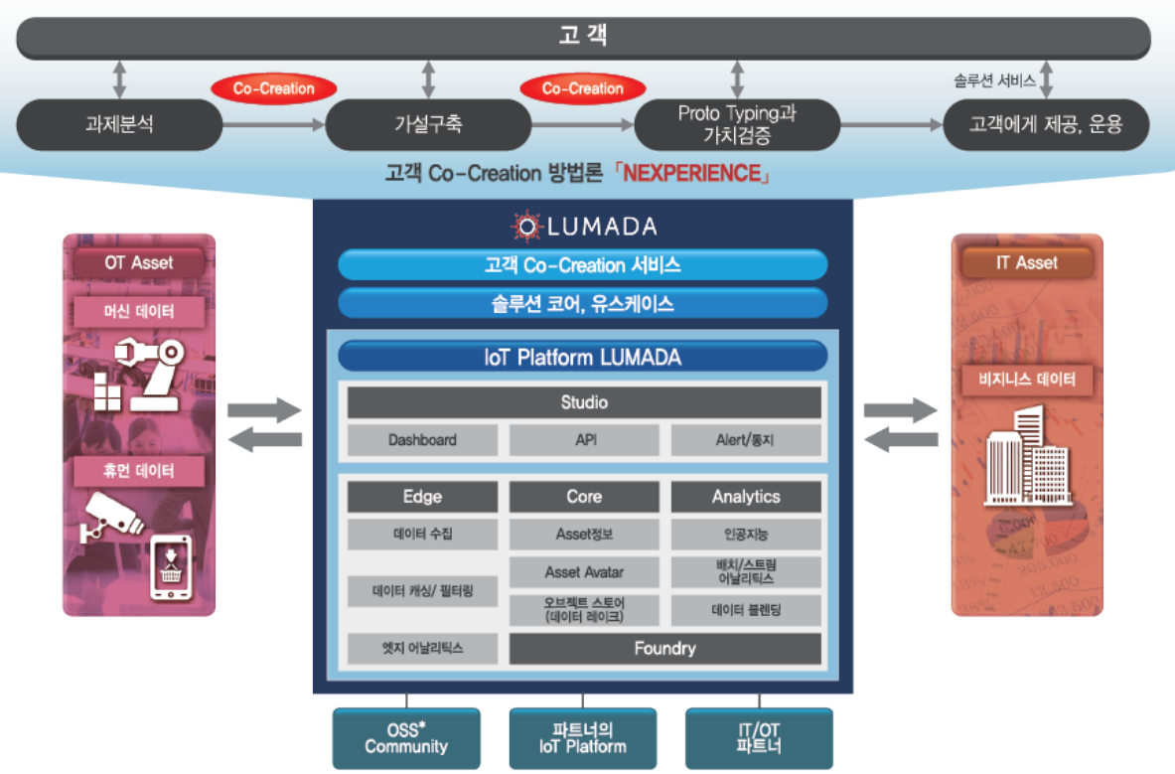
IOT Data management
http://www.lghitachi.co.kr/products/iot/lumada/index.jsp

Slide 21
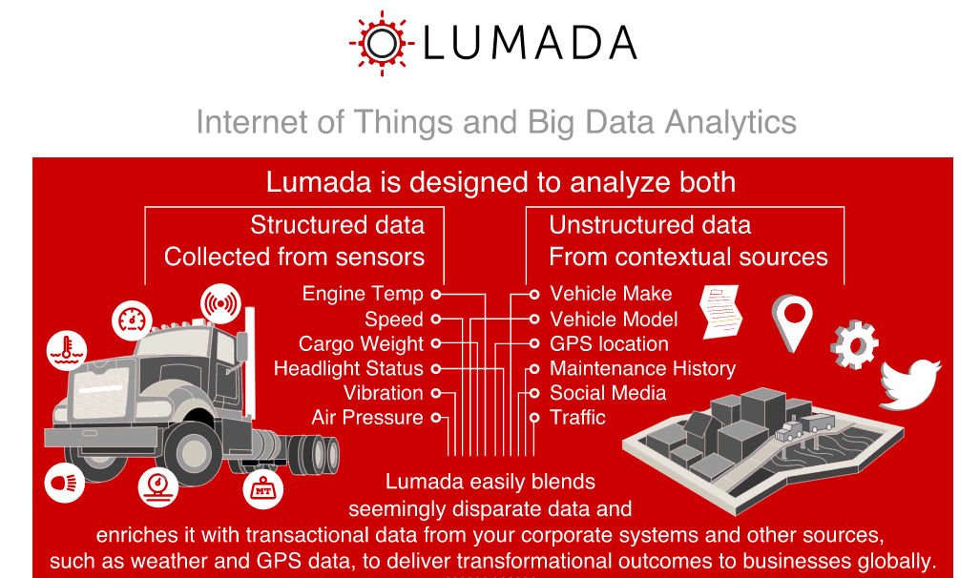
IOT Data management
http://www.lghitachi.co.kr/products/iot/lumada/index.jsp

Slide 22
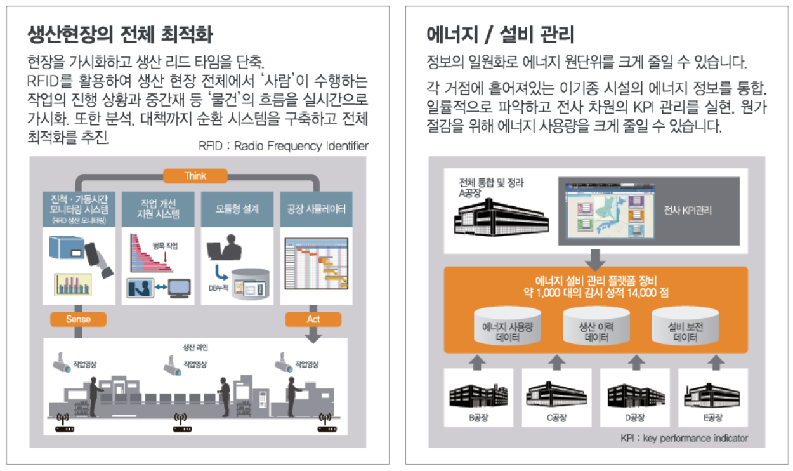
IOT Data management
http://www.lghitachi.co.kr/products/iot/lumada/index.jsp

Slide 23
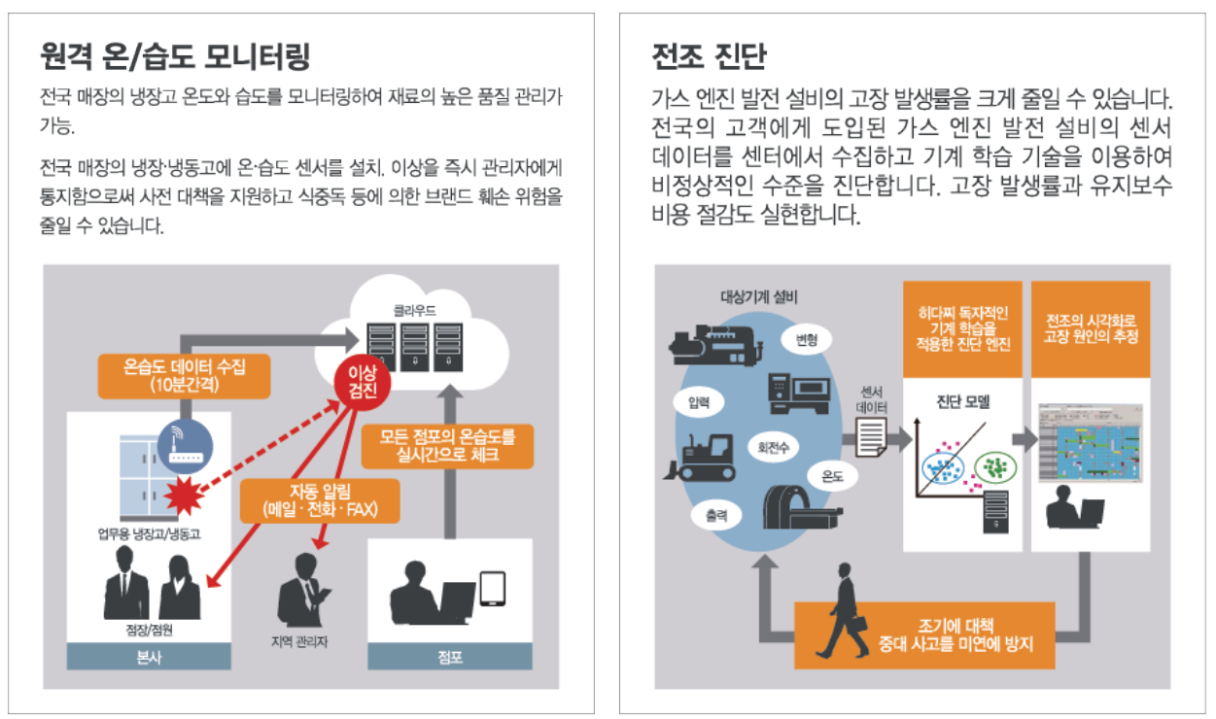
IOT Data management
http://www.lghitachi.co.kr/products/iot/lumada/index.jsp

Slide 24
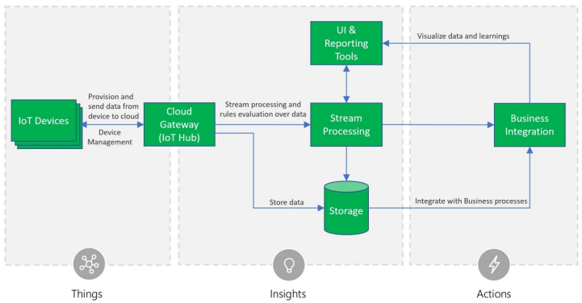
IOT Data management
https://aka.ms/iotrefarchitecture

Slide 25
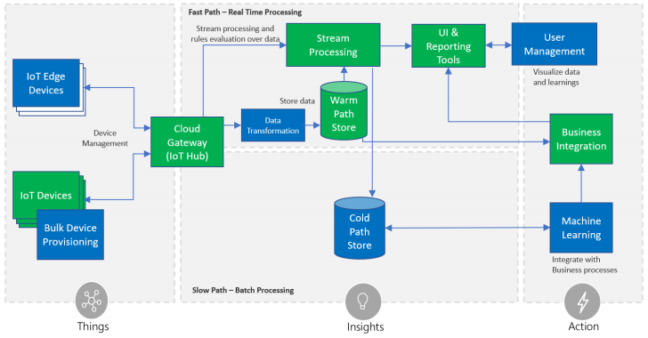
IOT Data management
https://aka.ms/iotrefarchitecture

Slide 26
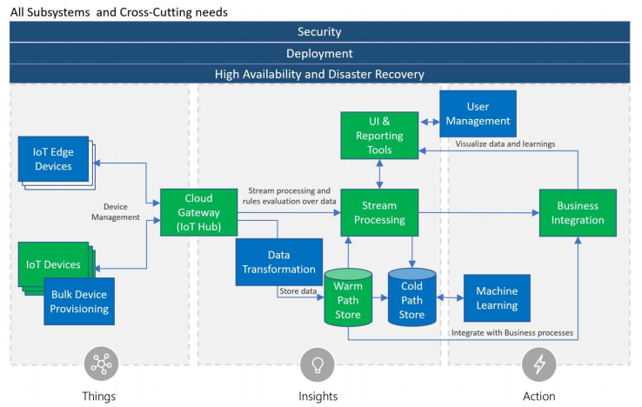
IOT Data management
https://aka.ms/iotrefarchitecture

Slide 27
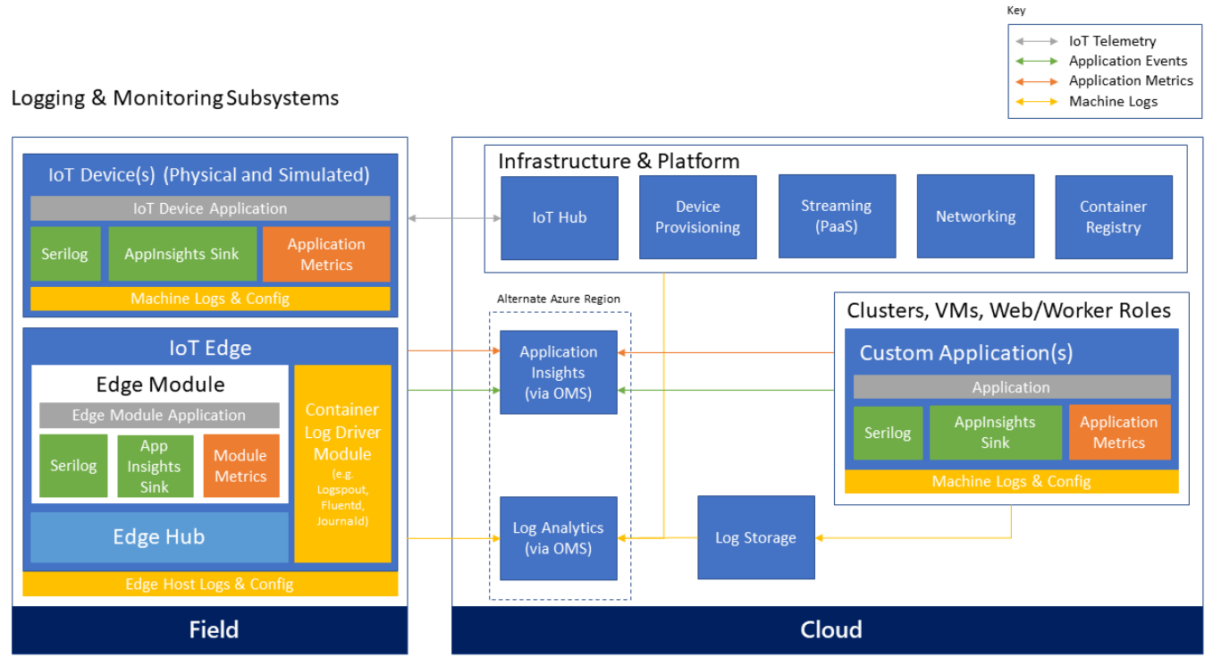
IOT Data management
https://aka.ms/iotrefarchitecture

Slide 28
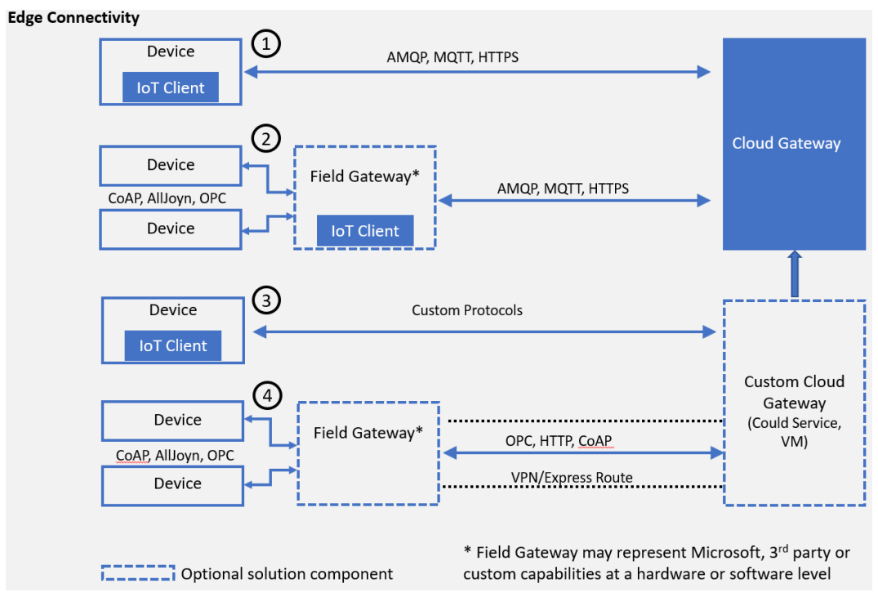
IOT Data management
https://aka.ms/iotrefarchitecture

Slide 29
DRIMAES AI Fleet Management System
Hybrid Cloud 기술

Slide 30
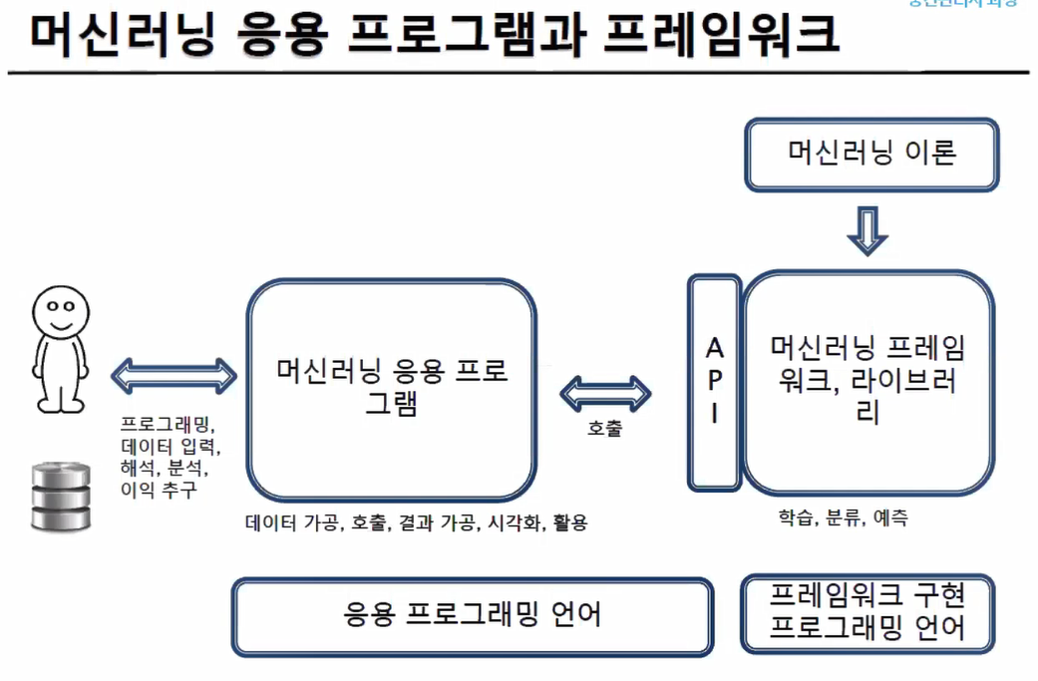
DRIMLAB AI Agile Development

Slide 31
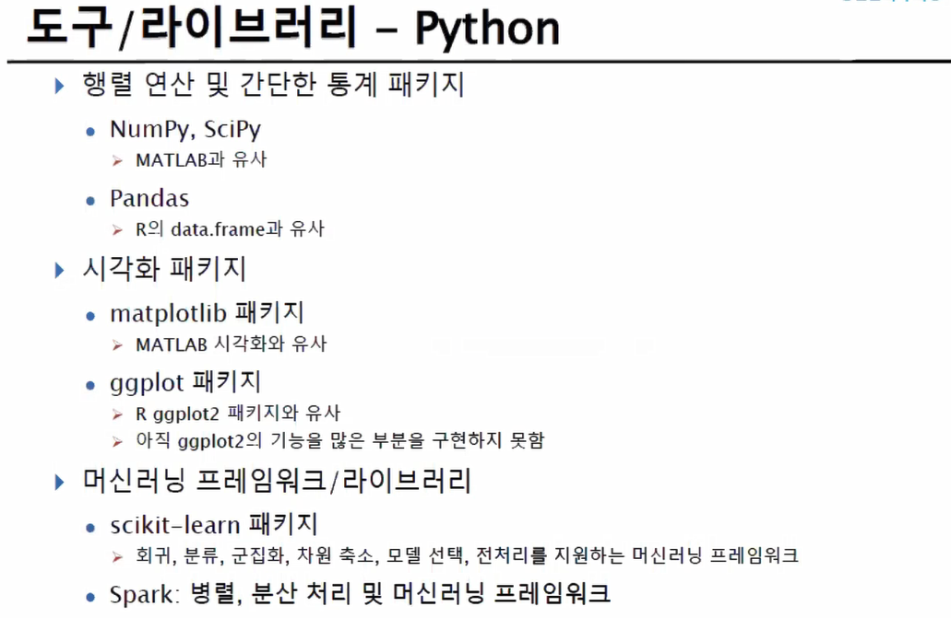
DRIMLAB AI Agile Development

Slide 32
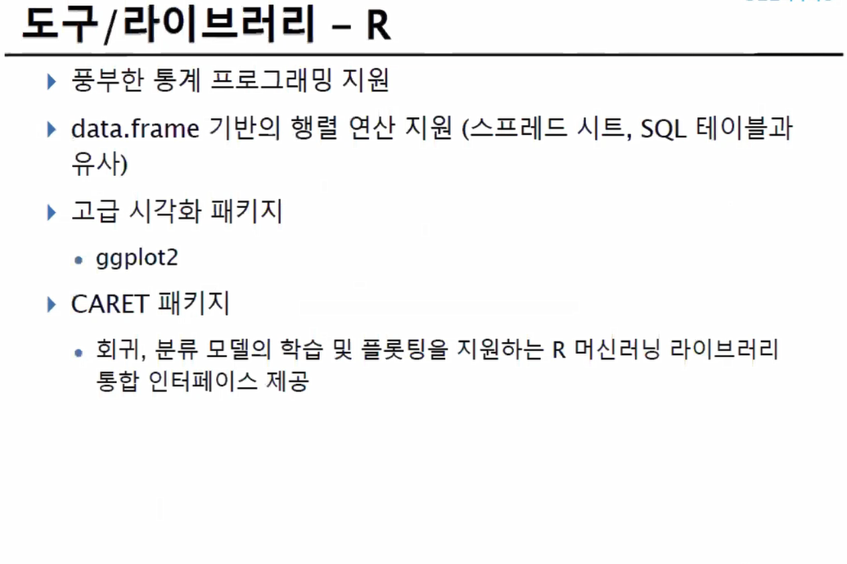
DRIMLAB AI Agile Development

Slide 33
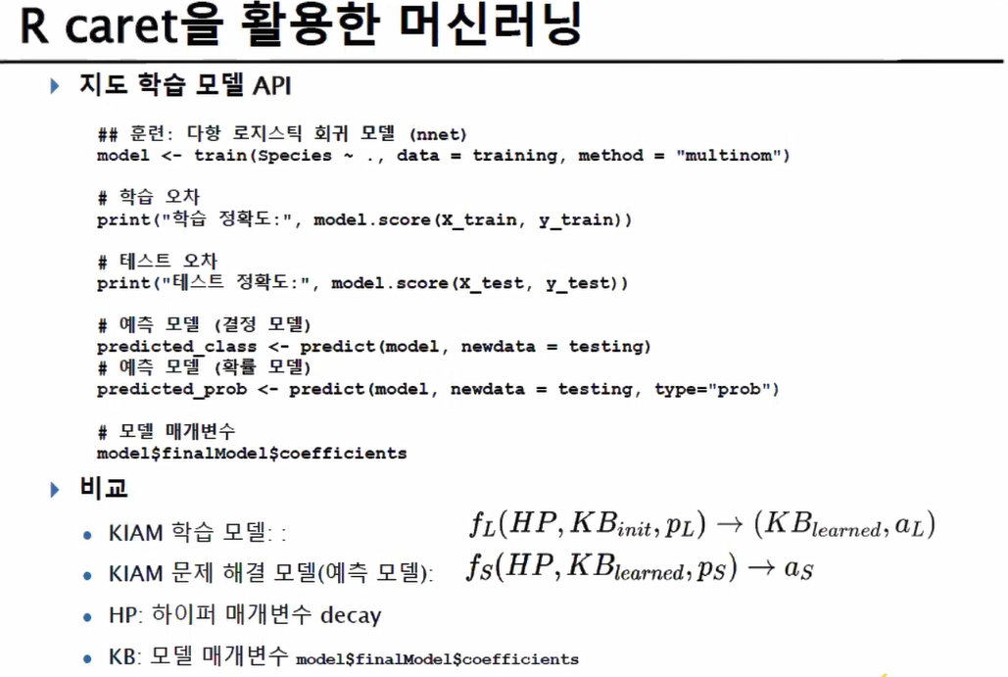
DRIMLAB AI Agile Development

Slide 34
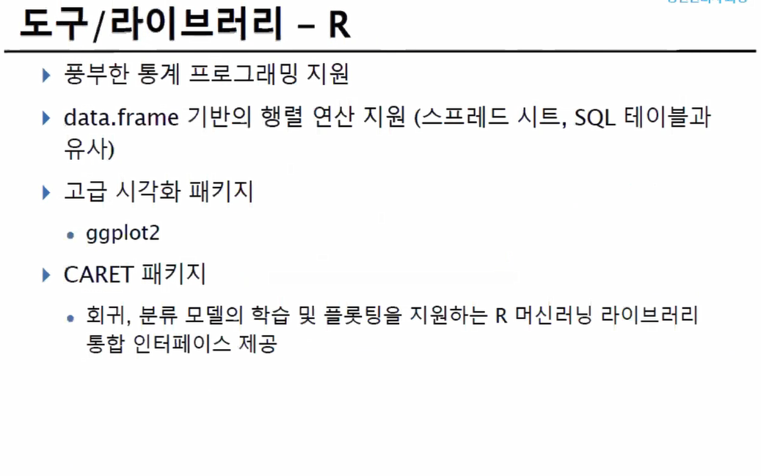
DRIMLAB AI Agile Development

Slide 35
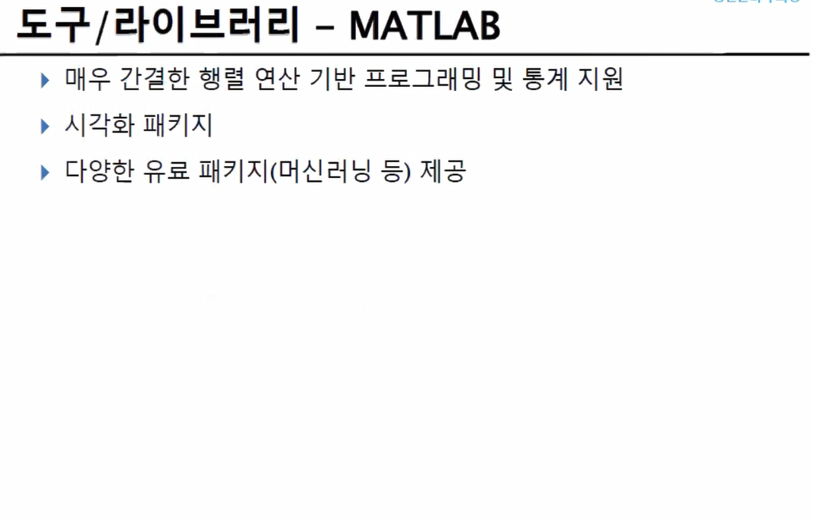
DRIMLAB AI Agile Development

Slide 36
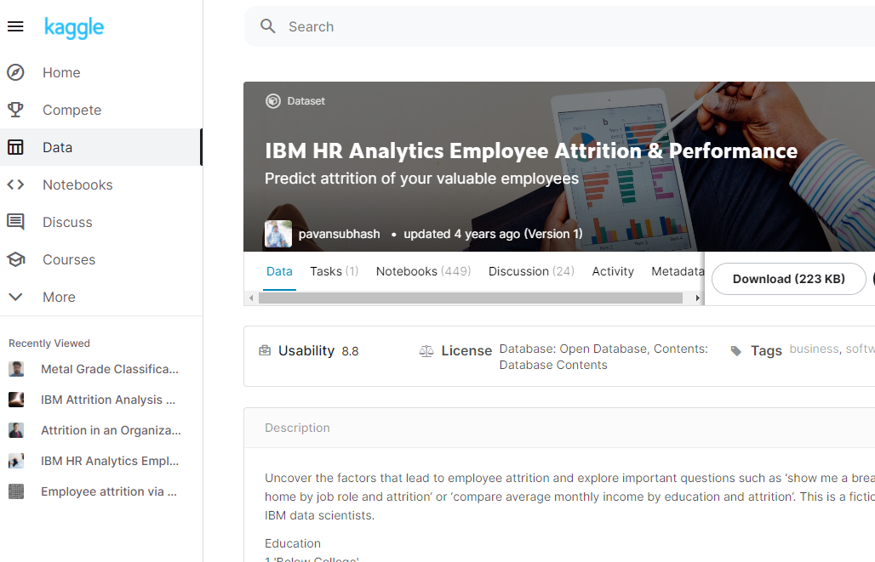
DRIMLAB AI Agile Development
예제) Kaggle, 데이터 분석
https://www.kaggle.com/pavansubhasht/ibm-hr-analytics-attrition-dataset

Slide 37
DRIMLAB AI Agile Development
예제) github, Time Series Analysis
https://github.com/DheerajKumar97/BitCoin-Price-Prediction
https://github.com/abhinavsagar/cryptocurrency-price-prediction
https://github.com/SC4RECOIN/LSTM-Crypto-Price-Prediction
https://github.com/amirrezaeian/Individual-household-electric-power-consumption-Data-Set-
https://github.com/AileenNielsen/TimeSeriesAnalysisWithPython Python
https://github.com/signaflo/java-timeseries JAVA
https://github.com/search?l=Java&q=time+series&type=Repositories JAVA
https://github.com/search?l=R&q=time+series&type=Repositories R
https://github.com/search?l=JavaScript&q=time+series&type=Repositories JS
https://github.com/search?l=C%2B%2B&q=time+series&type=Repositories C++

Slide 38
DRIMLAB AI Agile Development
예제) github, Object Detection
https://github.com/search?q=object+detection&type=Repositories
https://github.com/search?l=Python&q=object+detection&type=Repositories Python
https://github.com/search?l=Jupyter+Notebook&q=object+detection&type=Repositories Jupyter
https://github.com/search?l=C%2B%2B&q=object+detection&type=Repositories C++
https://github.com/search?l=Java&q=object+detection&type=Repositories JAVA
https://github.com/search?l=JavaScript&q=object+detection&type=Repositories JS
https://www.tensorflow.org/
https://www.tensorflow.org/install/lang_java JAVA
https://www.docker.com/ Docker

Slide 39
정보 수집
https://www.itfind.or.kr/ 지식 포털
https://www.aihub.or.kr/ AI 허브
https://www.data.go.kr/ 공공 데이터 포털
http://www.k-startup.go.kr/main.do 창업 지원 포털
http://www.bizinfo.go.kr/ 사업 정보
https://www.ntis.go.kr/rndgate/eg/un/ra/mng.do 국가 R&D 통합 공고
https://www.etnews.com/ 전자 신문
http://www.aitimes.kr/ 인공 지능 신문
https://arxiv.org/ arxiv 논문 검색
https://www.slideshare.net/ 슬라이드 쉐어
키워드 구글 검색
유투브 검색
Github 에서 키워드 검색

Slide 40
SNS
Facebook Groups
https://www.facebook.com/groups/TensorFlowKR/
https://www.facebook.com/groups/slamkr/
https://www.facebook.com/groups/JUGFK/
https://www.facebook.com/groups/datacommunity/
https://www.facebook.com/groups/ideaplan/
https://www.facebook.com/groups/1002540100134388/
YouTube
https://www.youtube.com/channel/UCQ2DWm5Md16Dc3xRwwhVE7Q EO
https://www.youtube.com/user/Talkitonair Talk IT
https://www.youtube.com/c/LearnOpenCV 영상처리
https://www.youtube.com/channel/UCe04fi-5jkRnSx7aEUAEisQ pickit3d
https://www.youtube.com/user/egoing2 생활코딩

Slide 41
온라인 학습/정보
https://www.mooc.org/ MOOC
http://www.kmooc.kr/ K-MOOC
http://www.gseek.or.kr/ 지식
https://www.coursera.org/ Coursera
https://www.khanacademy.org/ KHAN Academy
http://udacity.com/ UDACITY
http://udemy.com/ Udemy
https://www.edwith.org/ 에드위드
https://opentutorials.org/course/1 생활코딩
https://www.fastcampus.co.kr/ 패스트캠퍼스
https://www.inflearn.com/ 인프런
https://www.k-startup.go.kr/main.do K-Startup
http://www.bizinfo.go.kr/ 비즈인포
https://10times.com/ 전시회

Slide 42
Maker
https://www.devicemart.co.kr 디바이스 마트
https://kr.mouser.com/ 마우저
https://www.makeall.com/ 메이크올
https://developer.nvidia.com/ Nvidia 개발자
https://www.dfrobot.com/ DF로봇
https://dacon.io/ 경진대회
http://aifactory.space/ 경진대회
https://www.kaggle.com/ 경진대회

Slide 43
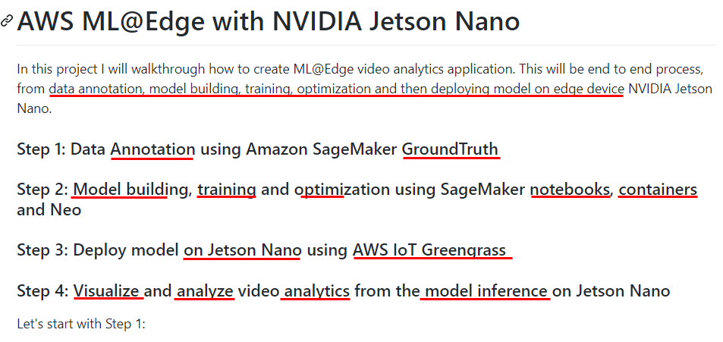
Edge Device
https://github.com/mahendrabairagi/AWS_ML_At_Edge_With_NVIDIA_Jetson_Nano

Slide 44
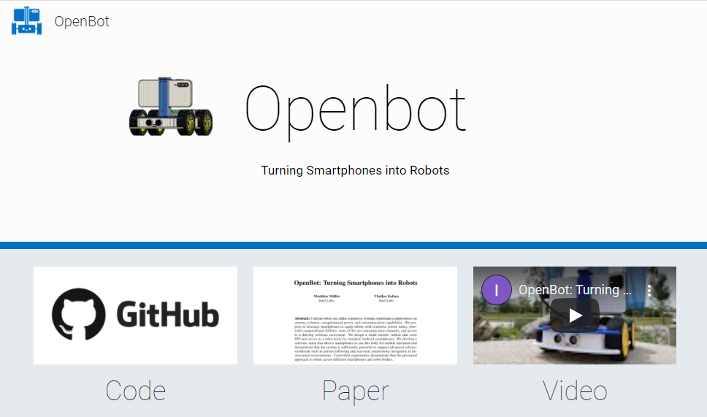
OpenBot
https://www.openbot.org/

Slide 45
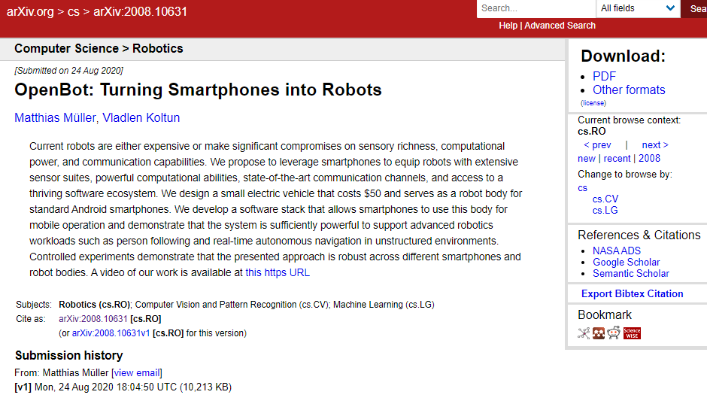
OpenBot
https://www.youtube.com/watch?v=qc8hFLyWDOM
https://arxiv.org/abs/2008.10631

Slide 46
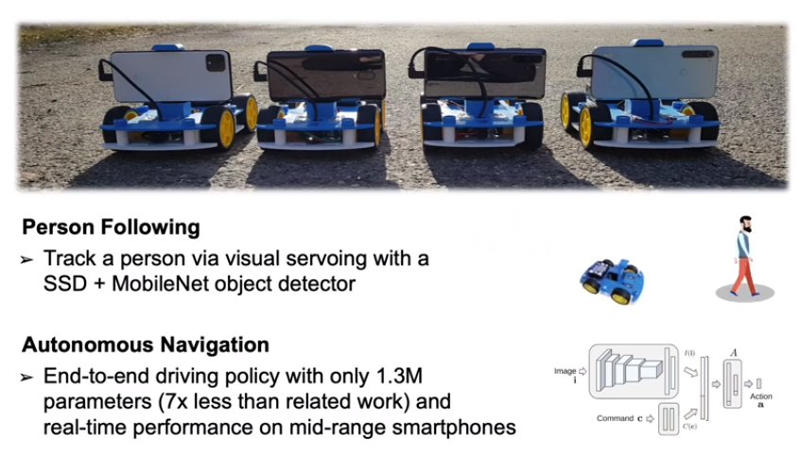
OpenBot
https://www.youtube.com/watch?v=qc8hFLyWDOM

Slide 47
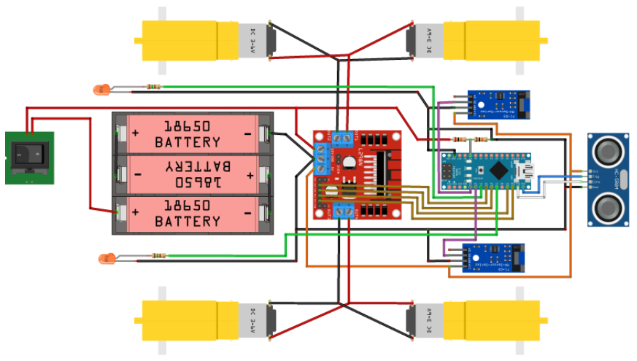
OpenBot
https://github.com/intel-isl/OpenBot/blob/master/body/README.md

Slide 48
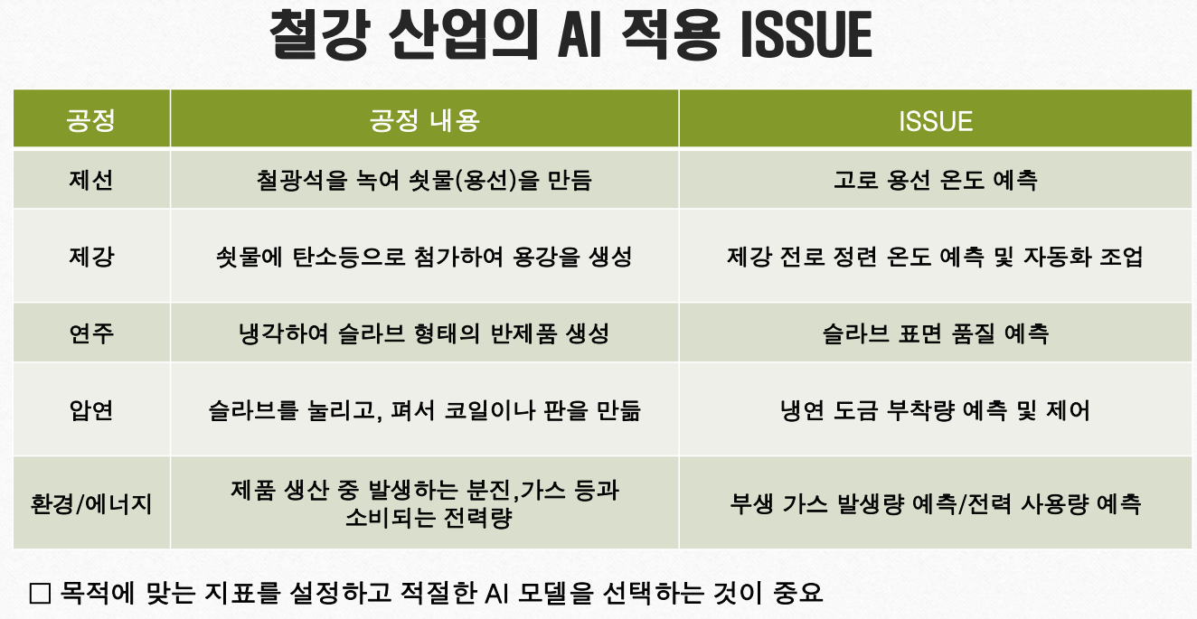
DRIMLAB AI Agile Development
http://www.kosmia.or.kr/download/20191002/[T4].pdf 철강 업종의 AI활용 사례

Slide 49
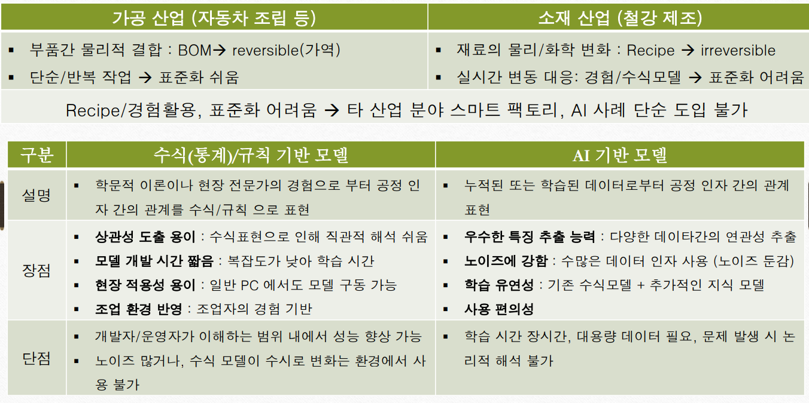
DRIMLAB AI Agile Development
http://www.kosmia.or.kr/download/20191002/[T4].pdf 철강 업종의 AI활용 사례

Slide 50
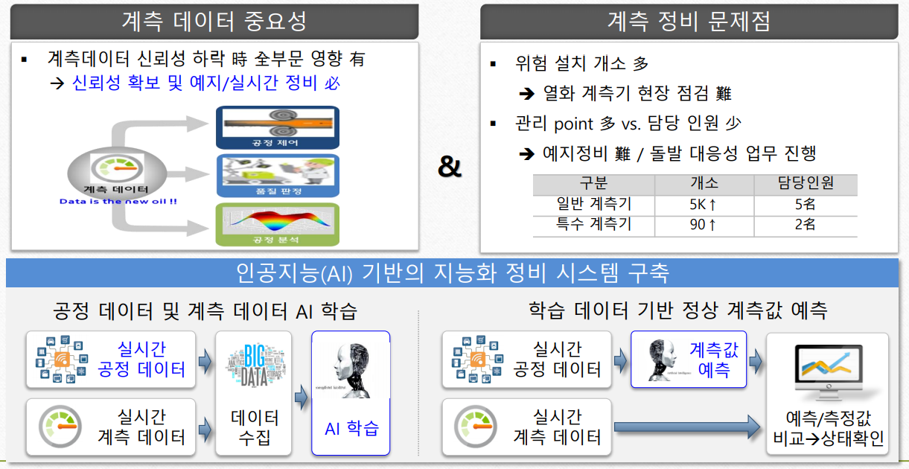
DRIMLAB AI Agile Development
http://www.kosmia.or.kr/download/20191002/[T4].pdf 철강 업종의 AI활용 사례

Slide 51
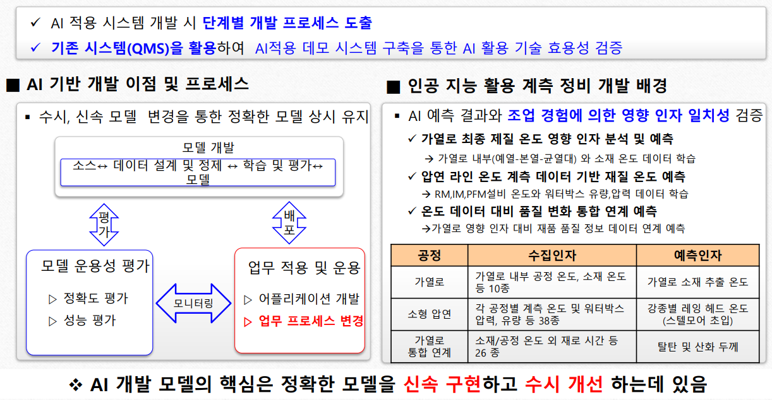
DRIMLAB AI Agile Development
http://www.kosmia.or.kr/download/20191002/[T4].pdf 철강 업종의 AI활용 사례

Slide 52
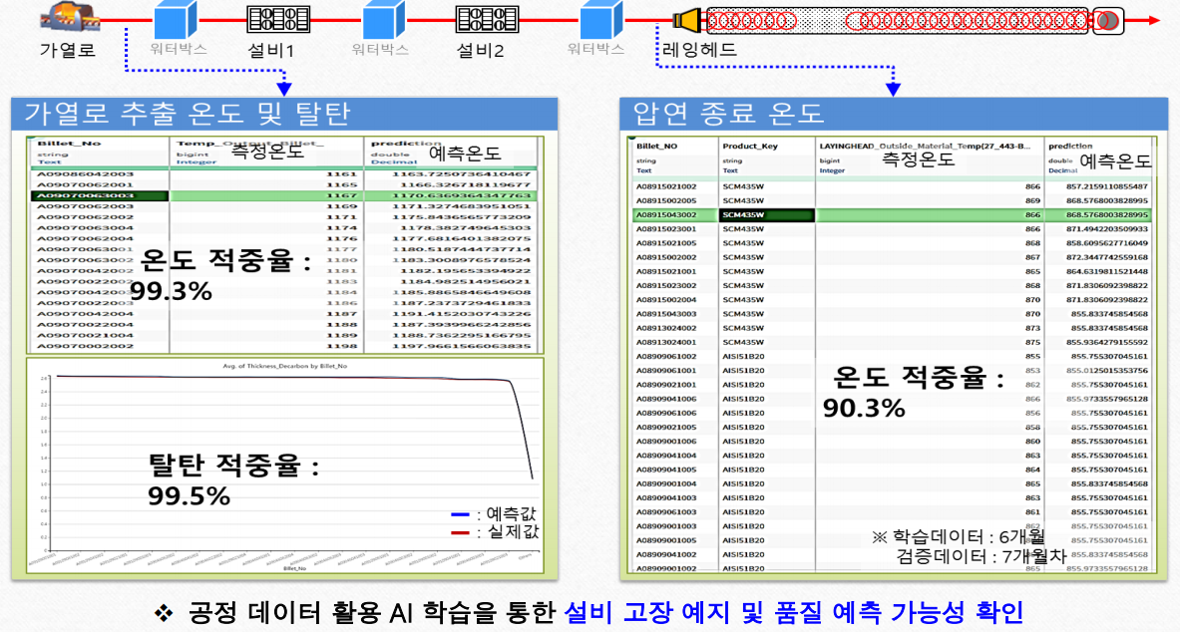
DRIMLAB AI Agile Development
http://www.kosmia.or.kr/download/20191002/[T4].pdf 철강 업종의 AI활용 사례

Slide 53
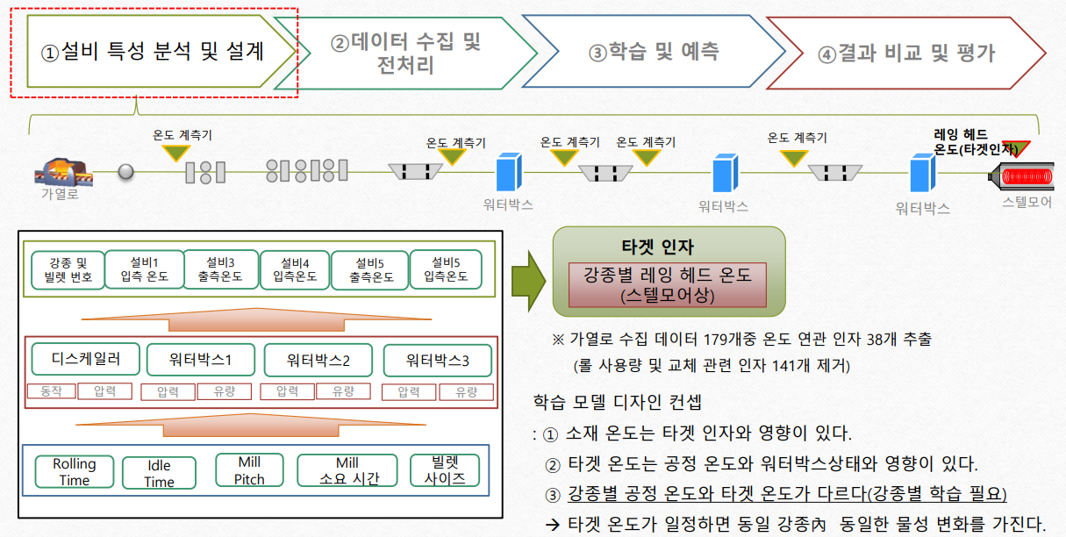
DRIMLAB AI Agile Development
http://www.kosmia.or.kr/download/20191002/[T4].pdf 철강 업종의 AI활용 사례

Slide 54
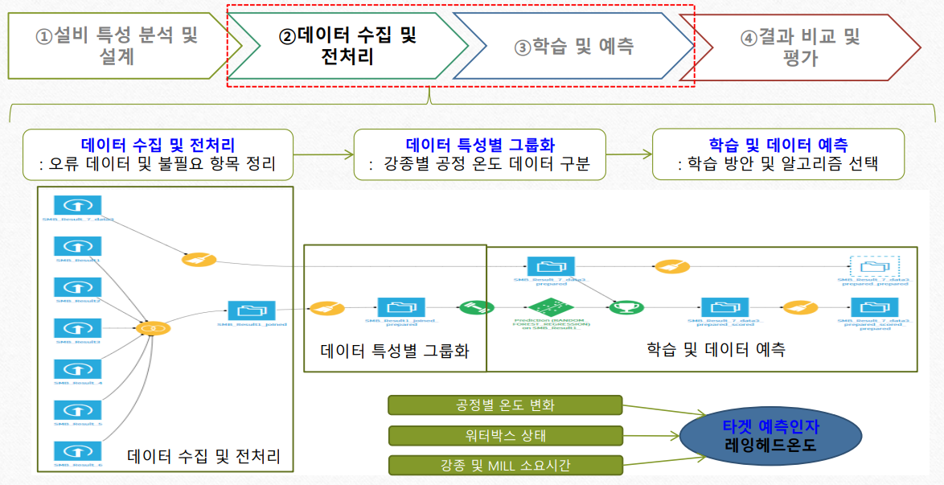
DRIMLAB AI Agile Development
http://www.kosmia.or.kr/download/20191002/[T4].pdf 철강 업종의 AI활용 사례

Slide 55
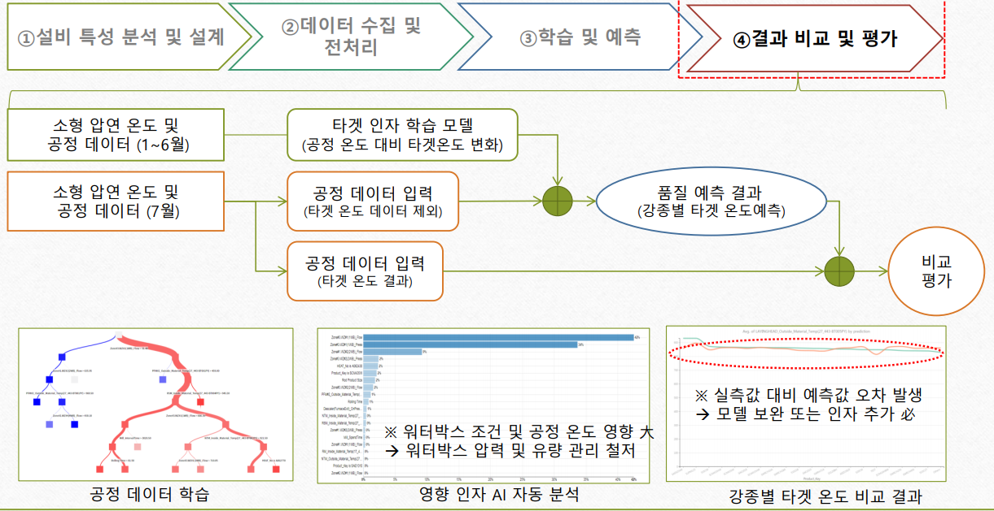
DRIMLAB AI Agile Development
http://www.kosmia.or.kr/download/20191002/[T4].pdf 철강 업종의 AI활용 사례

Slide 56
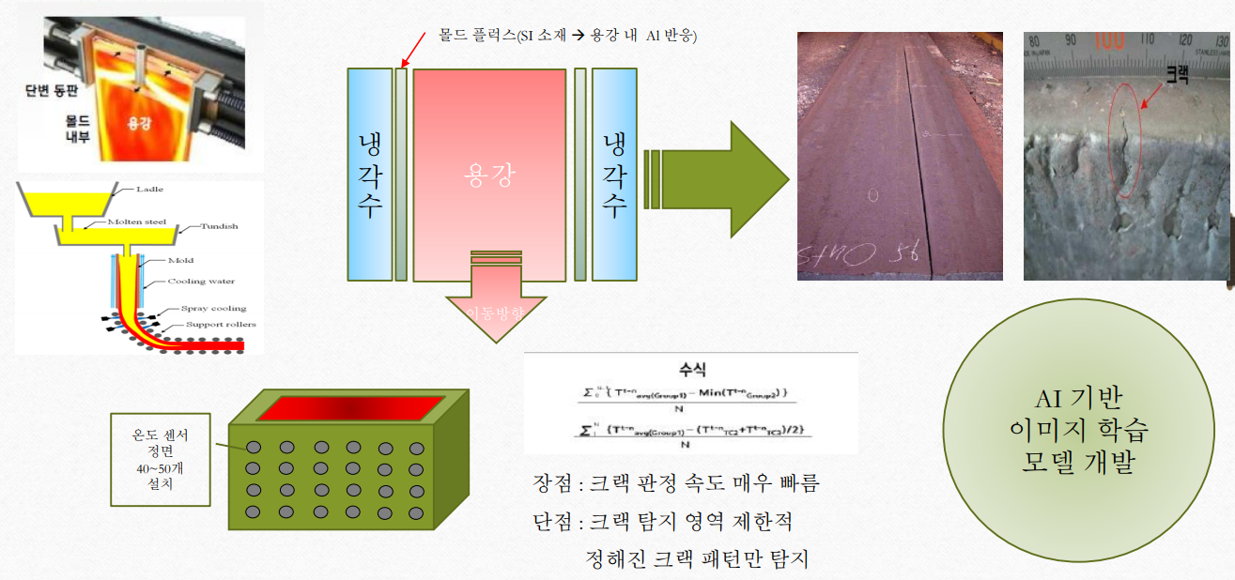
DRIMLAB AI Agile Development
http://www.kosmia.or.kr/download/20191002/[T4].pdf 철강 업종의 AI활용 사례

Slide 57
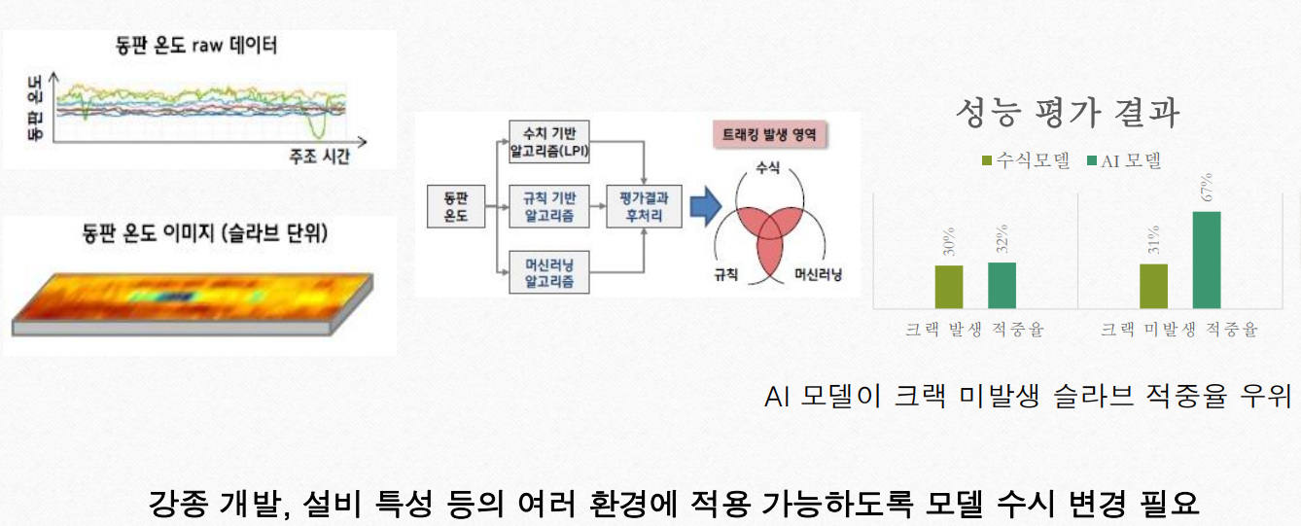
DRIMLAB AI Agile Development
http://www.kosmia.or.kr/download/20191002/[T4].pdf 철강 업종의 AI활용 사례

Slide 58
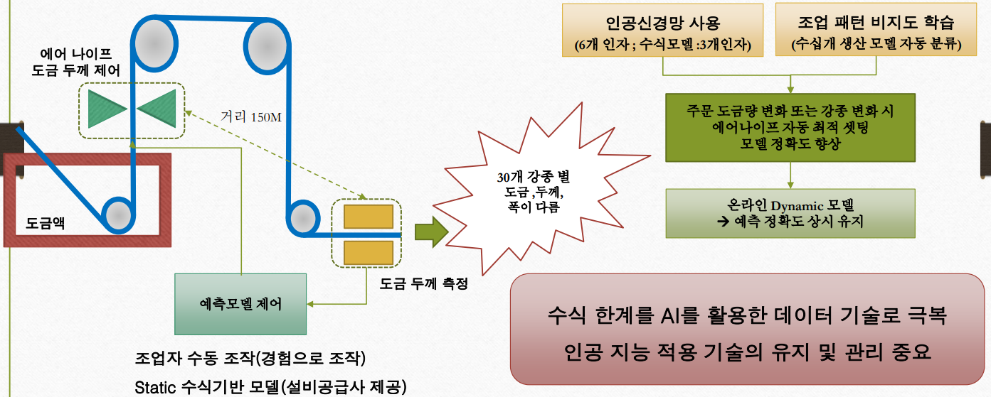
DRIMLAB AI Agile Development
http://www.kosmia.or.kr/download/20191002/[T4].pdf 철강 업종의 AI활용 사례

Slide 59
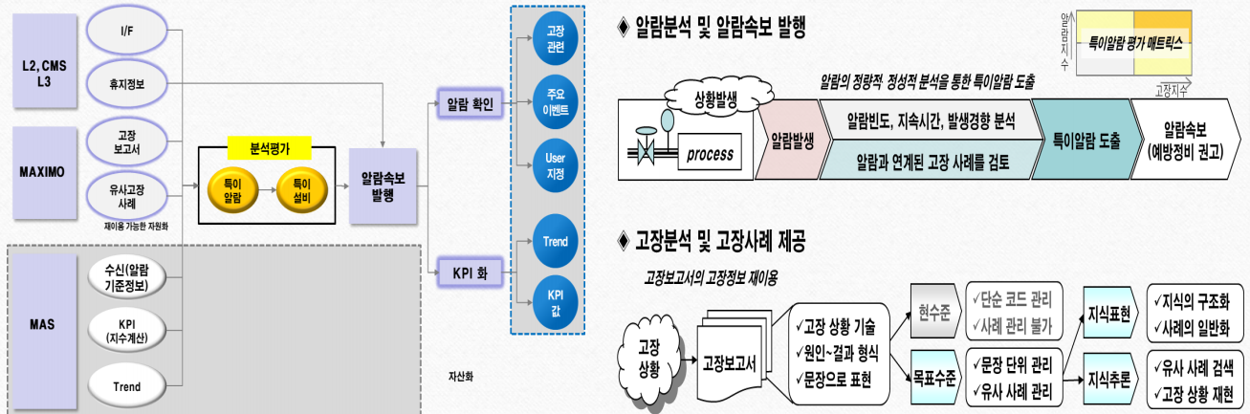
DRIMLAB AI Agile Development
http://www.kosmia.or.kr/download/20191002/[T4].pdf 철강 업종의 AI활용 사례

Slide 60
DRIMLAB AI Agile Development
http://www.kosmia.or.kr/download/20191002/[T4].pdf 철강 업종의 AI활용 사례

Slide 61
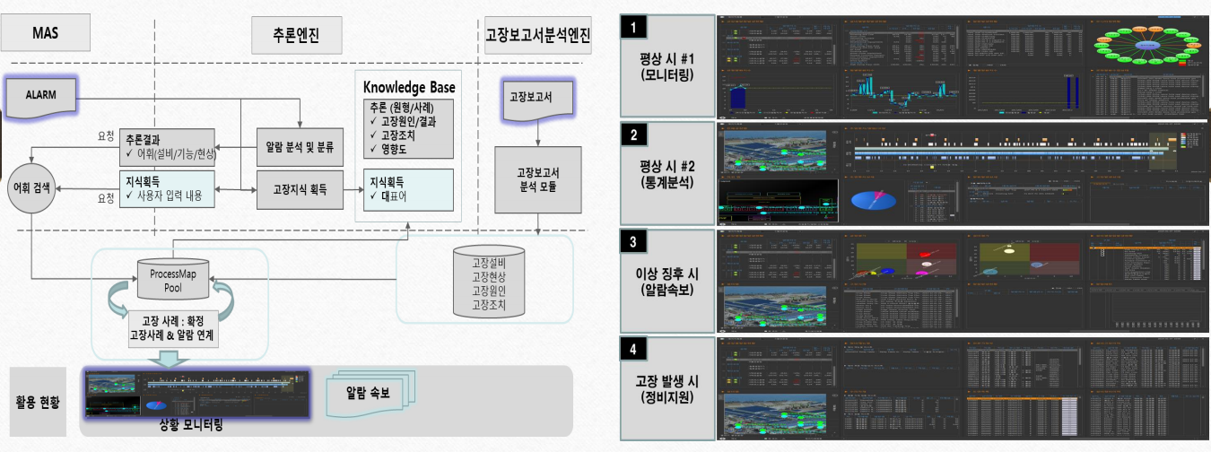
DRIMLAB AI Agile Development
http://www.kosmia.or.kr/download/20191002/[T4].pdf 철강 업종의 AI활용 사례

Slide 62
DRIMLAB AI Agile Development
http://www.kosmia.or.kr/download/20191002/[T4].pdf 철강 업종의 AI활용 사례

Slide 63
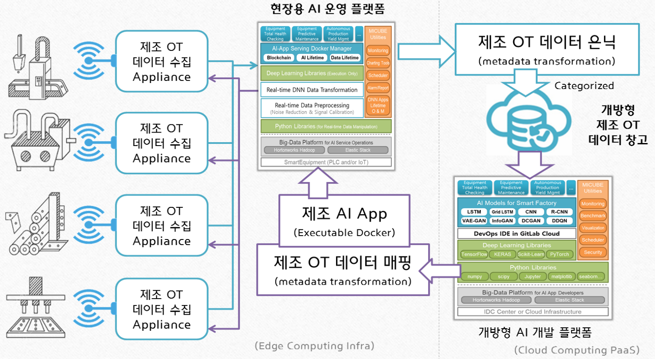
DRIMLAB AI Agile Development
http://www.kosmia.or.kr/download/20191002/[T4].pdf 철강 업종의 AI활용 사례

Slide 64
DRIMLAB AI Agile Development
Edge
스마트폰에서
앱 쓰듯이
Cloud
현장에서 모델 사용
모델 개발
http://www.kosmia.or.kr/download/20191002/[T4].pdf 철강 업종의 AI활용 사례

Slide 65
산업분야 : 전자기기개발
감사합니다
김희원 kimhe1@drimlab.com
https://www.linkedin.com/in/heewon-kim-95531724/

